Slide 1
Fuels

Slide 2
The main types of fuel
The main fuels that we use today for the generation of energy are:
Coal
Natural Gas
Mainly made up of Methane
Petroleum
This is a mixture of Hydrocarbons, this is used in car engines.

Slide 3
Coal
The remains of really old trees.
This is fossil fuel and so produces Sulphur dioxide.

Slide 4
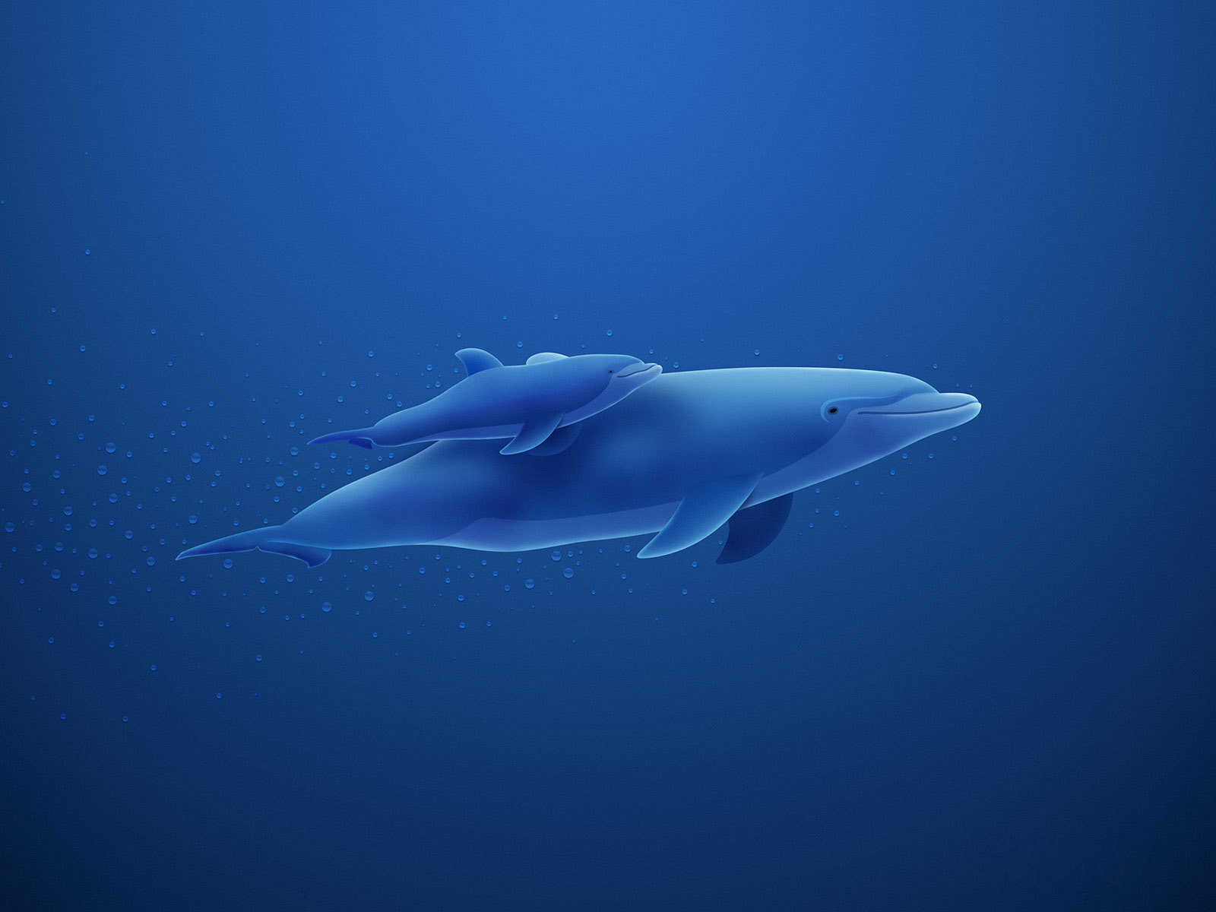
Fractional Distillation
Fractional distillation is the process of the separation of fuels from crude oil
The first fraction is the fraction that has the lowest boiling point and the last one is the one that has the lowest

Slide 5
