Slide 1
Mass & weight
Understand the concept of inertia and it relation to mass.
Understand that inertia is independent of the gravitational field strength it is in.
Understand the term gravitational field strength (g)

Slide 2
Mass & weight
F = ma
g = F/m
p28,29
g = gravitational field strength

Slide 3
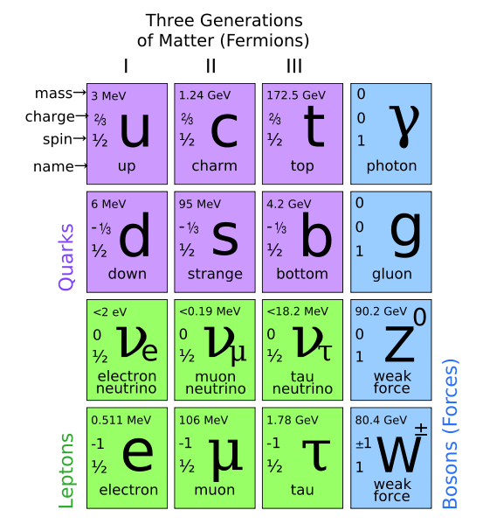
Matter in the universe:
5% normal matter
25% dark matter
70% dark energy
Higgs particle (BOSON):
needed to account for mass
Also need “graviton”

Slide 4
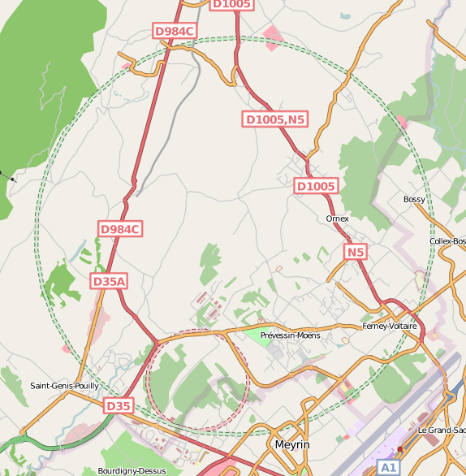
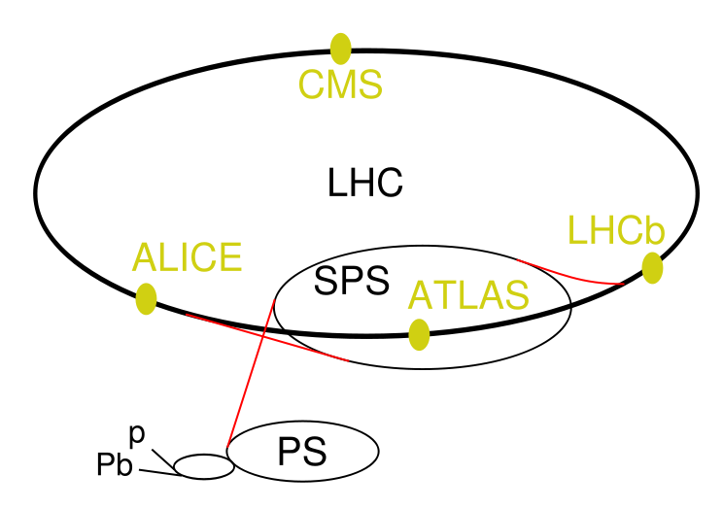

Slide 5
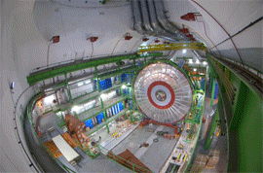

Slide 6
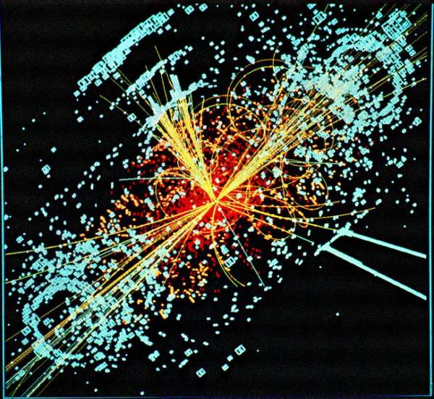

Slide 7
Key words you should now recognise...
Homework:
Read about the search for the Higg’s boson.
Write a one page summary.
Inertia
Field strength

